Slide 1
Integrated Sensing and Communications Lecturer: Dr. Rui Wang

Slide 2
Sensing
To detect the location, motion of mobile devices, vehicles or human
Sensing may improve the communication efficiency
Sensing may also provide services other than communications

Slide 3
IEEE 802.11bf
“802.11bf is a new Task Group about WLAN sensing within the IEEE 802.11 working group.”
“WLAN sensing is the use, by a WLAN sensing capable STA(s), of received WLAN signals to detect feature(s) of an intended target(s) in a given environment.”

Slide 4
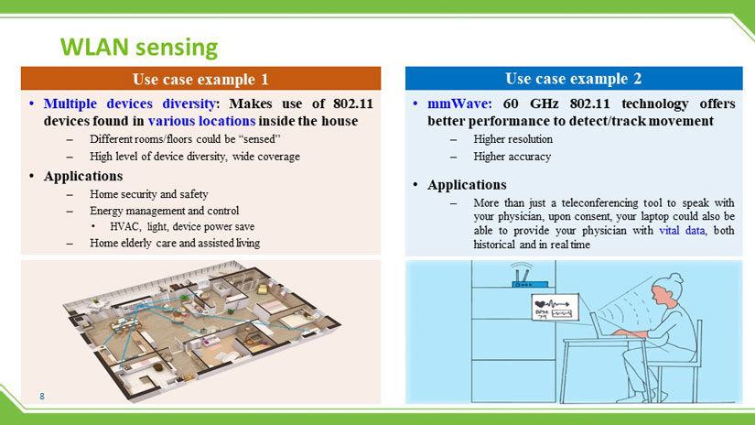
IEEE 802.11bf

Slide 5
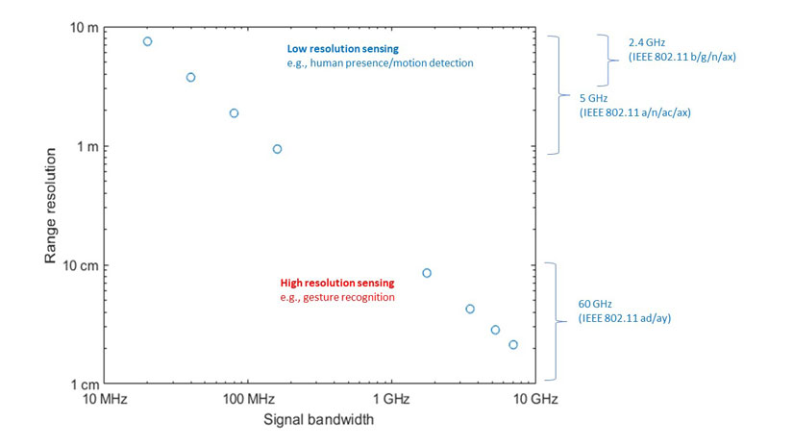
IEEE 802.11bf

Slide 6
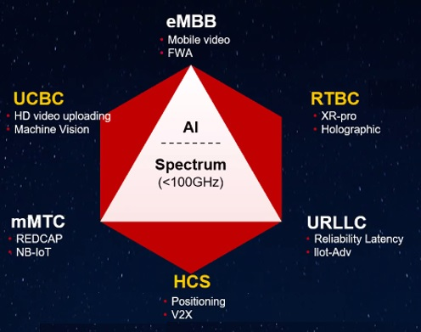
Sensing in 3GPP
Currently, 5G is not so successful in applications
Industry tries to define new application scenarios for cellular systems
Huawei: 5.5G

Slide 7
Sensing Modes and Parameters
Distance to the BS or mobile devices
Angles
Velocity
Motion
Proactive and passive

Slide 8


Proactive Sensing
Data Signals
Velocity v

Slide 9
Proactive Sensing
Data Signals
Echo
Velocity v

Slide 10
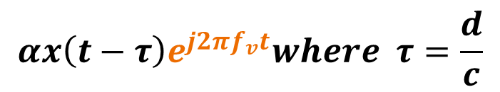
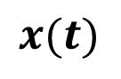
Proactive Sensing
$$x(t)$$
$$αx\left(t−τ\right)e^{j2πf_{v}t}where τ=\frac{d}{c}$$
Data Signals
Echo
Velocity v
$f_{v}$ is the Doppler frequency at car = $\frac{vf_{c}}{c}$

Slide 11
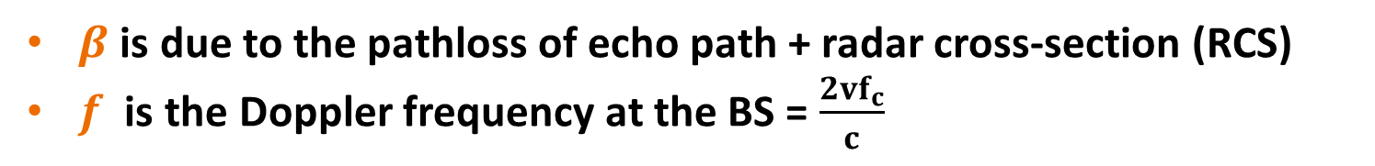
Proactive Sensing
$$x(t)$$
$$αx\left(t−τ\right)e^{j2πf_{v}t}where τ=\frac{d}{c}$$
Data Signals
Echo
$$αβx\left(t−2τ\right)e^{j2πft}$$
Velocity v
$β$ is due to the pathloss of echo path + radar cross-section (RCS)
$f$ is the Doppler frequency at the BS = $\frac{2vf_{c}}{c}$

Slide 12
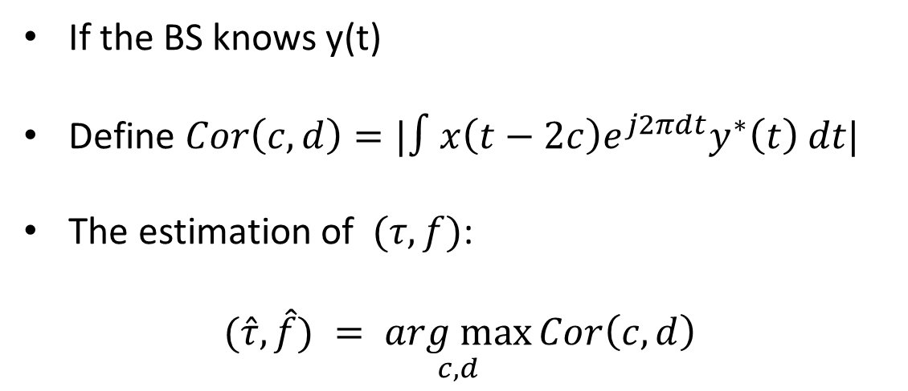
Proactive Sensing
$$x(t)$$
If the BS knows y(t)
Define $Cor\left(c,d\right)=|∫x\left(t−2c\right)e^{j2πdt}y^{∗}\left(t\right) dt|$
The estimation of $(τ,f)$:
$$(\hat{τ},\hat{f}) = \underset{c,d}{arg max}{Cor\left(c,d\right)}$$
$$y\left(t\right)= αβx\left(t−2τ\right)e^{j2πft}$$

Slide 13
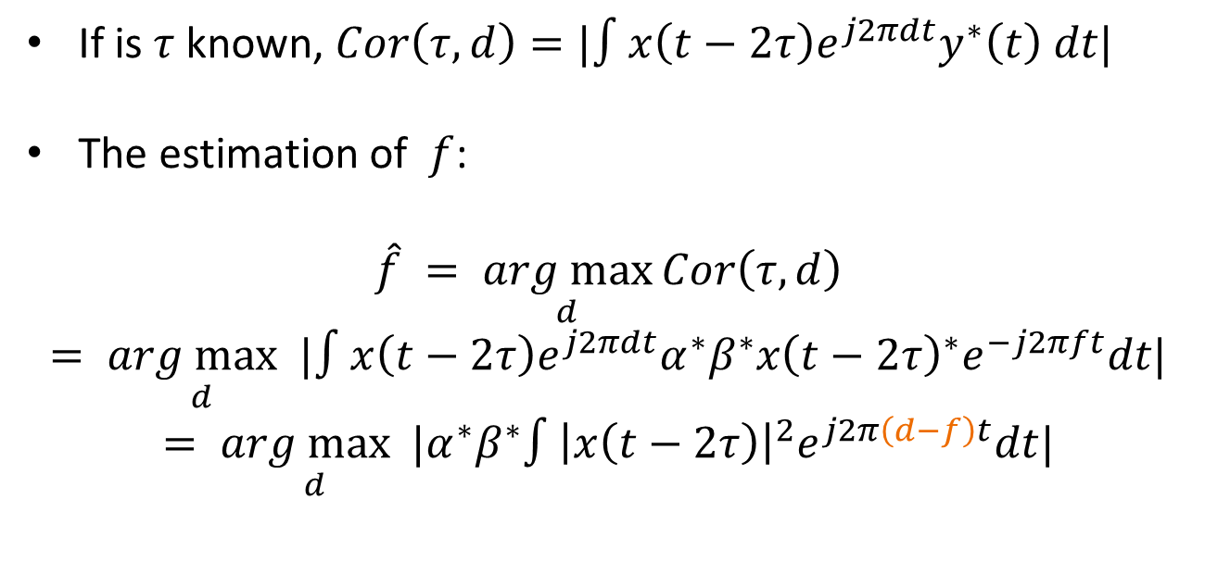
Proactive Sensing: Analysis
$$x(t)$$
If is $τ$known, $Cor\left(τ,d\right)=|∫x\left(t−2τ\right)e^{j2πdt}y^{∗}\left(t\right) dt|$
The estimation of $f$:
$$\hat{f} = \underset{d}{arg max}{Cor\left(τ,d\right)}$$
$$= \underset{d}{arg max}|∫x\left(t−2τ\right)e^{j2πdt}α^{∗}β^{∗}x{\left(t−2τ\right)}^{∗}e^{−j2πft}dt|$$
$$= \underset{d}{arg max}|α^{∗}β^{∗}∫{\left|x\left(t−2τ\right)\right|}^{2}e^{j2π\left(d−f\right)t}dt|$$
$$y\left(t\right)= αβx\left(t−2τ\right)e^{j2πft}$$

Slide 14
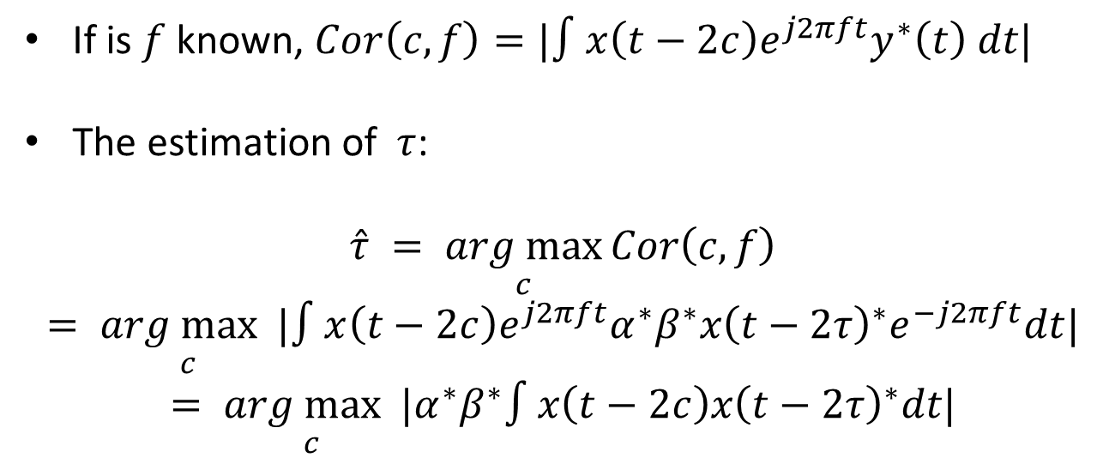
Proactive Sensing: Analysis
$$x(t)$$
If is $f$known, $Cor\left(c,f\right)=|∫x\left(t−2c\right)e^{j2πft}y^{∗}\left(t\right) dt|$
The estimation of $τ$:
$$\hat{τ} = \underset{c}{arg max}{Cor\left(c,f\right)}$$
$$= \underset{c}{arg max}|∫x\left(t−2c\right)e^{j2πft}α^{∗}β^{∗}x{\left(t−2τ\right)}^{∗}e^{−j2πft}dt|$$
$$= \underset{c}{arg max}|α^{∗}β^{∗}∫x\left(t−2c\right)x{\left(t−2τ\right)}^{∗}dt|$$
$$y\left(t\right)= αβx\left(t−2τ\right)e^{j2πft}$$

Slide 15
Proactive Sensing: Full Duplexing
$$x(t)$$
The BS should knows y(t)
BS is sending x(t) => It must be full duplex
Full duplex is currently a huge challenge for data transceiver design
$$y\left(t\right)= αβx\left(t−2τ\right)e^{j2πft}$$

Slide 16
Proactive Sensing: TDMA
$$x(t)$$
The BS sends the radar and data waves in different time
Radar wave: Frequency Modulated Continuous Wave (FMCW)
Only require full duplexing in FMCW transmission – Easy-peasy
$$y\left(t\right)= αβx\left(t−2τ\right)e^{j2πft}$$

Slide 17
Passive Sensing
Data Signals
Echo

Slide 18

Passive Sensing
Data Signals
Data Signals
Echo
Passive Receiver

Slide 19
Passive Sensing
BS or car may not know the existence of passive receiver.
Surveillance Channel
Reference Channel
Passive Receiver

Slide 20

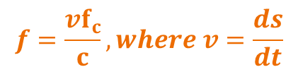
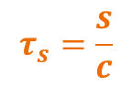
Passive Sensing
$$x(t)$$
$$τ_{s}=\frac{s}{c}$$
$$f=\frac{vf_{c}}{c}, where v=\frac{ds}{dt}$$
$$s$$
V is not the actual velocity of car
Surveillance Channel
Reference Channel
$$y_{s}\left(t\right)= βx\left(t−τ_{s}\right)e^{j2πft}$$
$$y_{r}\left(t\right)=αx\left(t−τ_{r}\right)$$
Passive Receiver

Slide 21
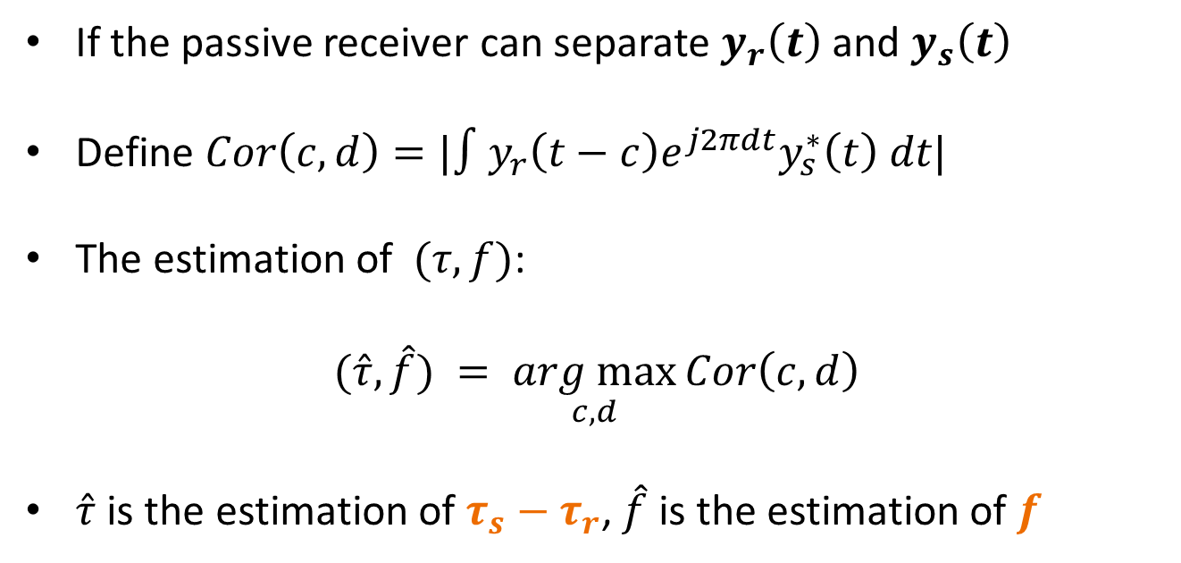
Passive Sensing
If the passive receiver can separate $y_{r}\left(t\right)$ and $y_{s}\left(t\right)$
Define $Cor\left(c,d\right)=|∫y_{r}\left(t−c\right)e^{j2πdt}y_{s}^{∗}\left(t\right) dt|$
The estimation of $(τ,f)$:
$$(\hat{τ},\hat{f}) = \underset{c,d}{arg max}{Cor\left(c,d\right)}$$
$\hat{τ}$ is the estimation of $τ_{s}−τ_{r}$, $\hat{f}$ is the estimation of $f$
$$y_{r}\left(t\right)=αx\left(t−τ_{r}\right)$$
$$y_{s}\left(t\right)= βx\left(t−τ_{s}\right)e^{j2πft}$$

Slide 22


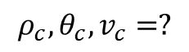
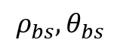
Passive Sensing
$$ρ_{bs},θ_{bs}$$
$$ρ_{c},θ_{c},v_{c}=?$$

Slide 23
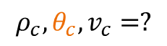
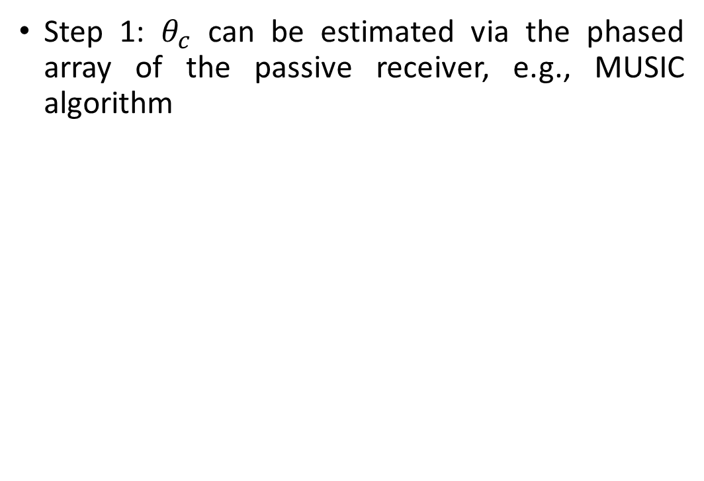
Passive Sensing
Step 1: $θ_{c}$ can be estimated via the phased array of the passive receiver, e.g., MUSIC algorithm
$$ρ_{bs},θ_{bs}$$
$$ρ_{c},θ_{c},v_{c}=?$$

Slide 24

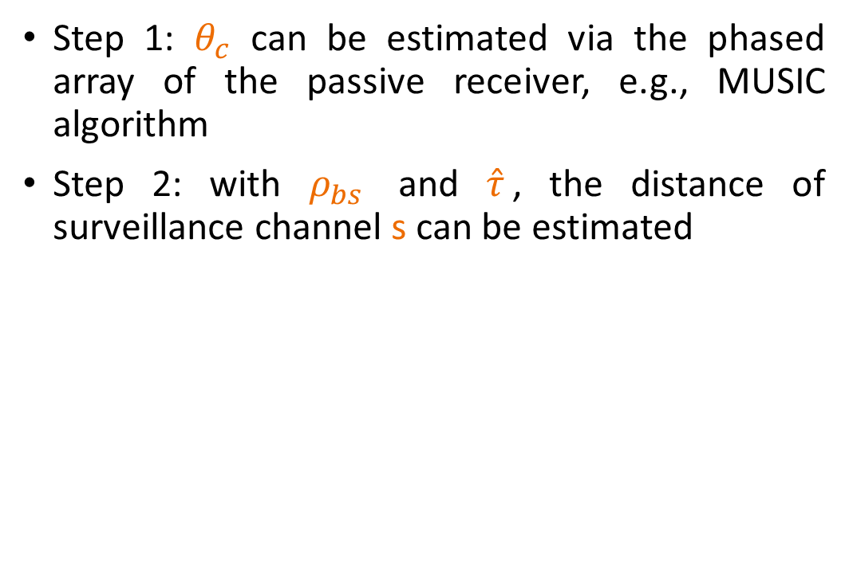
Passive Sensing
Step 1: $θ_{c}$ can be estimated via the phased array of the passive receiver, e.g., MUSIC algorithm
Step 2: with $ρ_{bs}$ and $\hat{τ}$, the distance of surveillance channel s can be estimated
$$s$$
$$ρ_{bs},θ_{bs}$$
$$ρ_{c},θ_{c},v_{c}=?$$

Slide 25
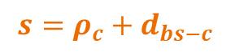
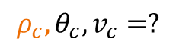
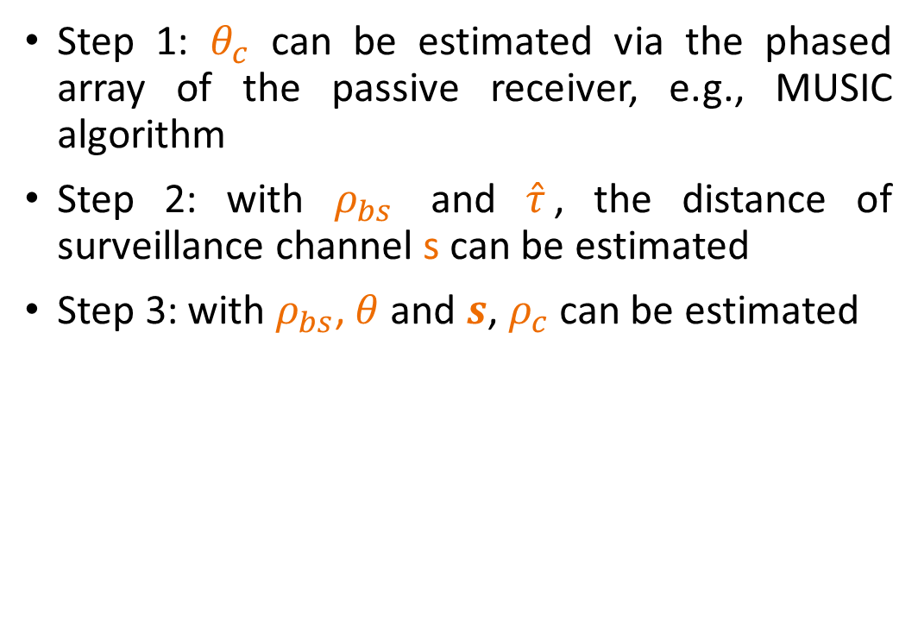
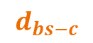
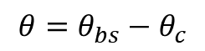
Passive Sensing
Step 1: $θ_{c}$ can be estimated via the phased array of the passive receiver, e.g., MUSIC algorithm
Step 2: with $ρ_{bs}$ and $\hat{τ}$, the distance of surveillance channel s can be estimated
Step 3: with $ρ_{bs}$, $θ$ and $s$, $ρ_{c}$ can be estimated
$$s=ρ_{c}+d_{bs−c}$$
$$d_{bs−c}$$
$$ρ_{bs},θ_{bs}$$
$$ρ_{c},θ_{c},v_{c}=?$$
$$θ=θ_{bs}−θ_{c}$$

Slide 26
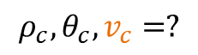
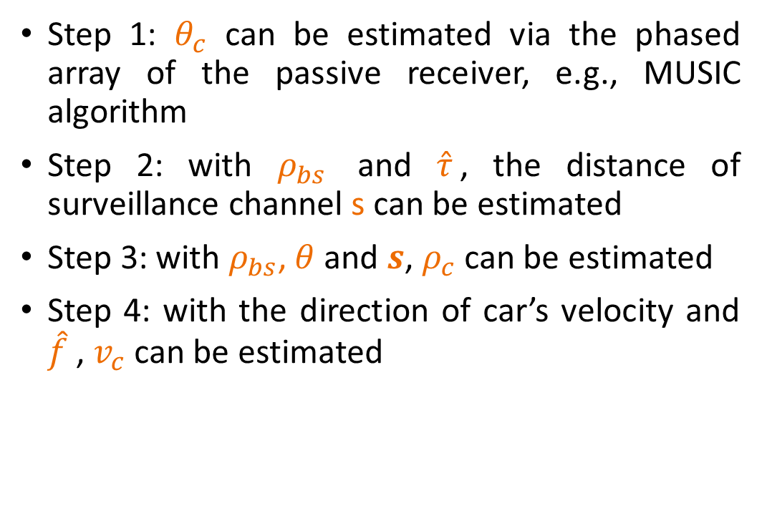
Passive Sensing
Step 1: $θ_{c}$ can be estimated via the phased array of the passive receiver, e.g., MUSIC algorithm
Step 2: with $ρ_{bs}$ and $\hat{τ}$, the distance of surveillance channel s can be estimated
Step 3: with $ρ_{bs}$, $θ$ and $s$, $ρ_{c}$ can be estimated
Step 4: with the direction of car’s velocity and $\hat{f}$ , $v_{c}$ can be estimated
$$s=ρ_{c}+d_{bs−c}$$
$$d_{bs−c}$$
$$ρ_{bs},θ_{bs}$$
$$ρ_{c},θ_{c},v_{c}=?$$
$$θ=θ_{bs}−θ_{c}$$

Slide 27
MUSIC Algorithm
multiple signal classification (MUSIC) algorithm is widely used to detect the Angle-of-Arrival (AoA) of antenna array
The number of AoAs should not be larger than the number of antennas
Spatial smoothing, improved algorithms, …

Slide 28
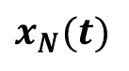
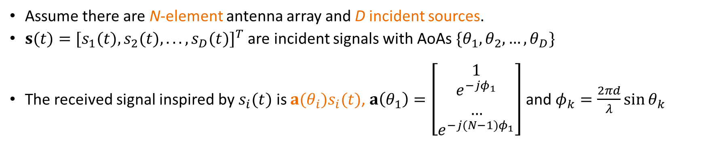
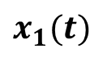
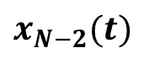
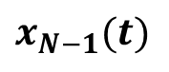
Signal Model
......
d
$$x_{N}(t)$$
$$x_{N−1}(t)$$
$$x_{N−2}(t)$$
$$x_{1}(t)$$
Assume there are N-element antenna array and D incident sources.
$s(t)=[s_{1}(t),s_{2}(t),...,s_{D}(t)]^{T}$ are incident signals with AoAs $\{θ_{1},θ_{2},…,θ_{D}\}$
The received signal inspired by $s_{i}(t)$ is $a(θ_{i})s_{i}(t)$, $a\left(θ_{1}\right)=\left[\begin{matrix}1 \\ \begin{aligned}e^{−jφ_{1}} \\ … \\ e^{−j(N−1)φ_{1}}\end{aligned}\end{matrix}\right]$ and $φ_{k}=\frac{2πd}{λ}\sin{θ_{k}}$

Slide 29
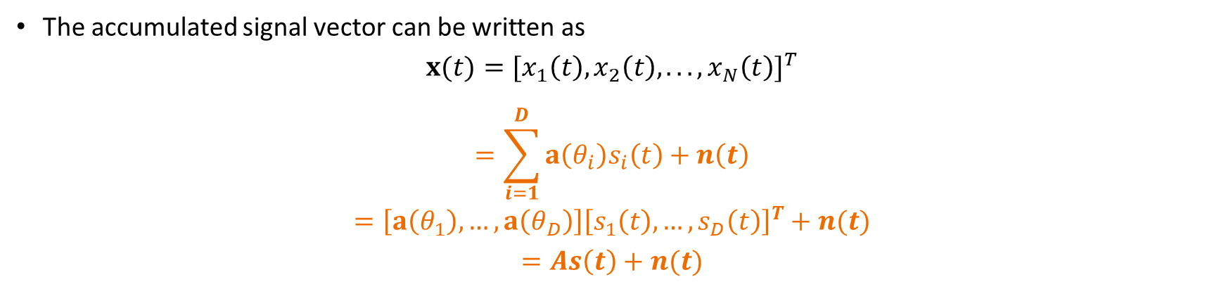
Signal Model
......
d
$$x_{N}(t)$$
$$x_{N−1}(t)$$
$$x_{N−2}(t)$$
$$x_{1}(t)$$
The accumulated signal vector can be written as
$$x(t)=[x_{1}\left(t\right),x_{2}\left(t\right),...,x_{N}\left(t\right)]^{T}$$
$$=\sum_{i=1}^{D}{a\left(θ_{i}\right)s_{i}\left(t\right)}+n\left(t\right)$$
$$=\left[a\left(θ_{1}\right),…,a\left(θ_{D}\right)\right]{\left[s_{1}\left(t\right),…, s_{D}\left(t\right)\right]}^{T}+n(t)$$
$$=As\left(t\right)+n(t)$$

Slide 30
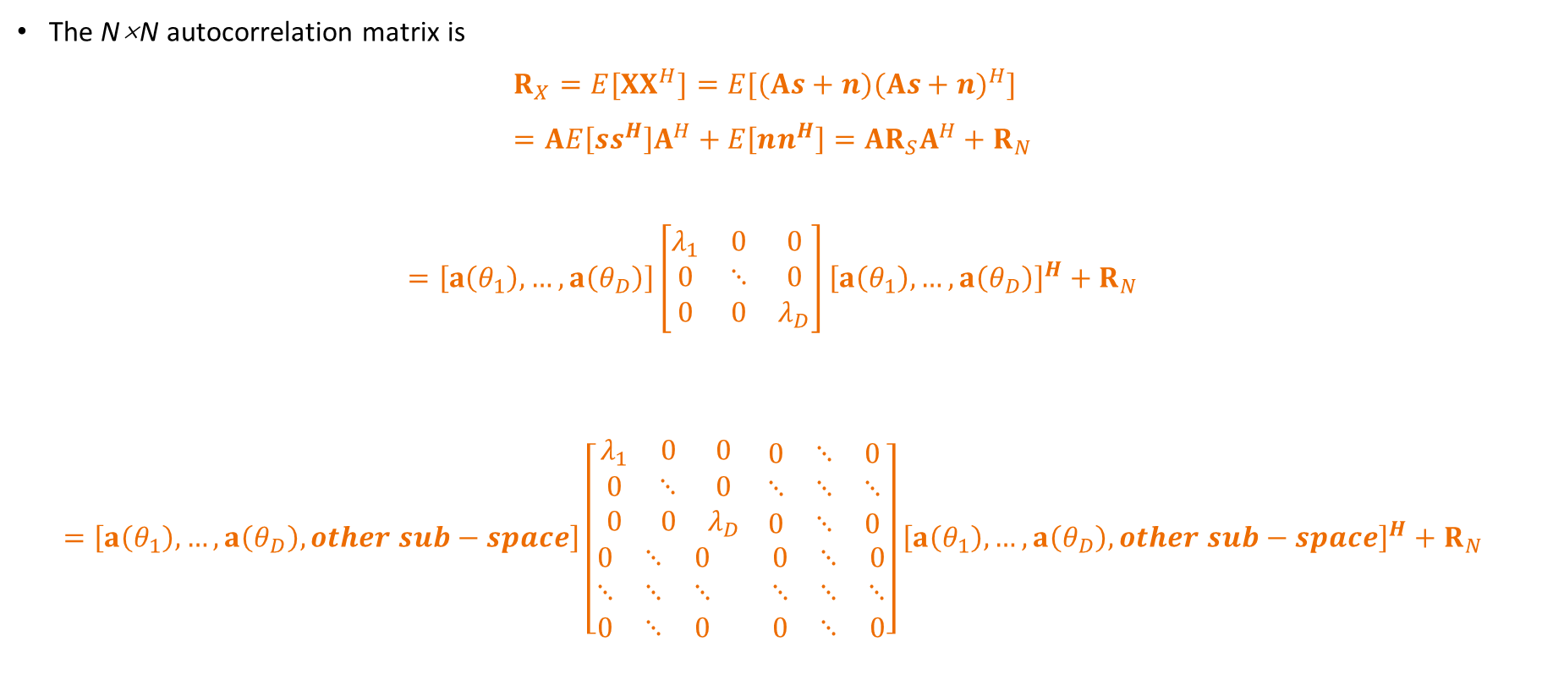
Covariance Matrix
The N×N autocorrelation matrix is
$$R_{X}=E[XX^{H}]=E[(As+n)(As+n)^{H}] \\ =AE\left[ss^{H}\right]A^{H}+E\left[nn^{H}\right]=AR_{S}A^{H}+R_{N}$$
$$=\left[a\left(θ_{1}\right),…,a\left(θ_{D}\right)\right]\left[\begin{matrix}λ_{1} & 0 & 0 \\ 0 & ⋱ & 0 \\ 0 & 0 & λ_{D}\end{matrix}\right]{\left[a\left(θ_{1}\right),…,a\left(θ_{D}\right)\right]}^{H}+R_{N}$$
$$=\left[a\left(θ_{1}\right),…,a\left(θ_{D}\right), other sub−space\right]\left[\begin{aligned}\begin{matrix}λ_{1} & 0 & 0 \\ 0 & ⋱ & 0 \\ 0 & 0 & λ_{D}\end{matrix} \begin{matrix}0 & ⋱ & 0 \\ ⋱ & ⋱ & ⋱ \\ 0 & ⋱ & 0\end{matrix} \\ \begin{matrix}0 & ⋱ & 0 \\ ⋱ & ⋱ & ⋱ \\ 0 & ⋱ & 0\end{matrix} \begin{matrix}0 & ⋱ & 0 \\ ⋱ & ⋱ & ⋱ \\ 0 & ⋱ & 0\end{matrix}\end{aligned}\right]{\left[a\left(θ_{1}\right),…,a\left(θ_{D}\right), other sub−space\right]}^{H}+R_{N}$$

Slide 31
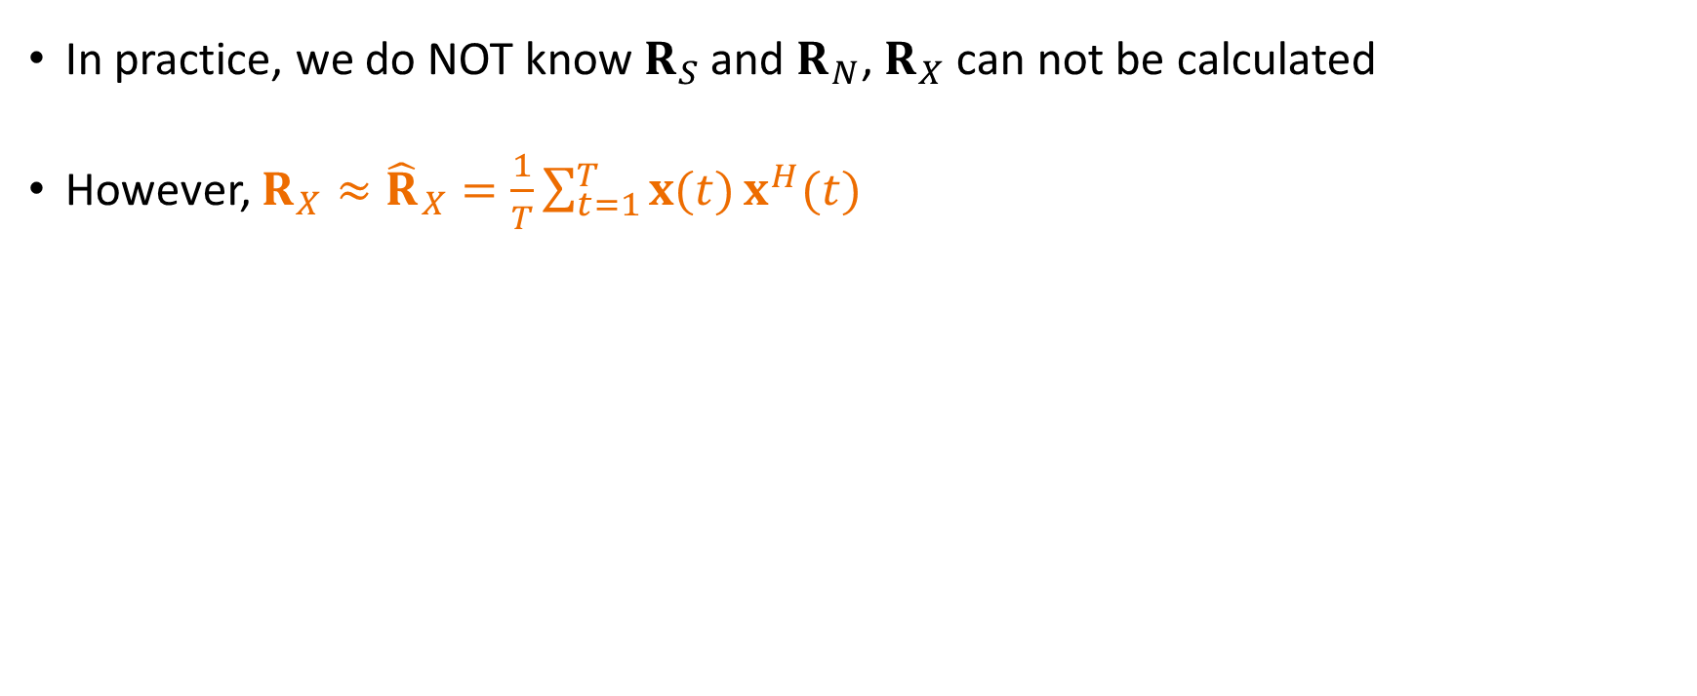
Covariance Matrix
In practice, we do NOT know $R_{S}$ and $R_{N}$, $R_{X}$ can not be calculated
However, ${R_{X}≈\hat{R}}_{X}=\frac{1}{T}\sum_{t=1}^{T}{x(t)}x^{H}(t)$

Slide 32

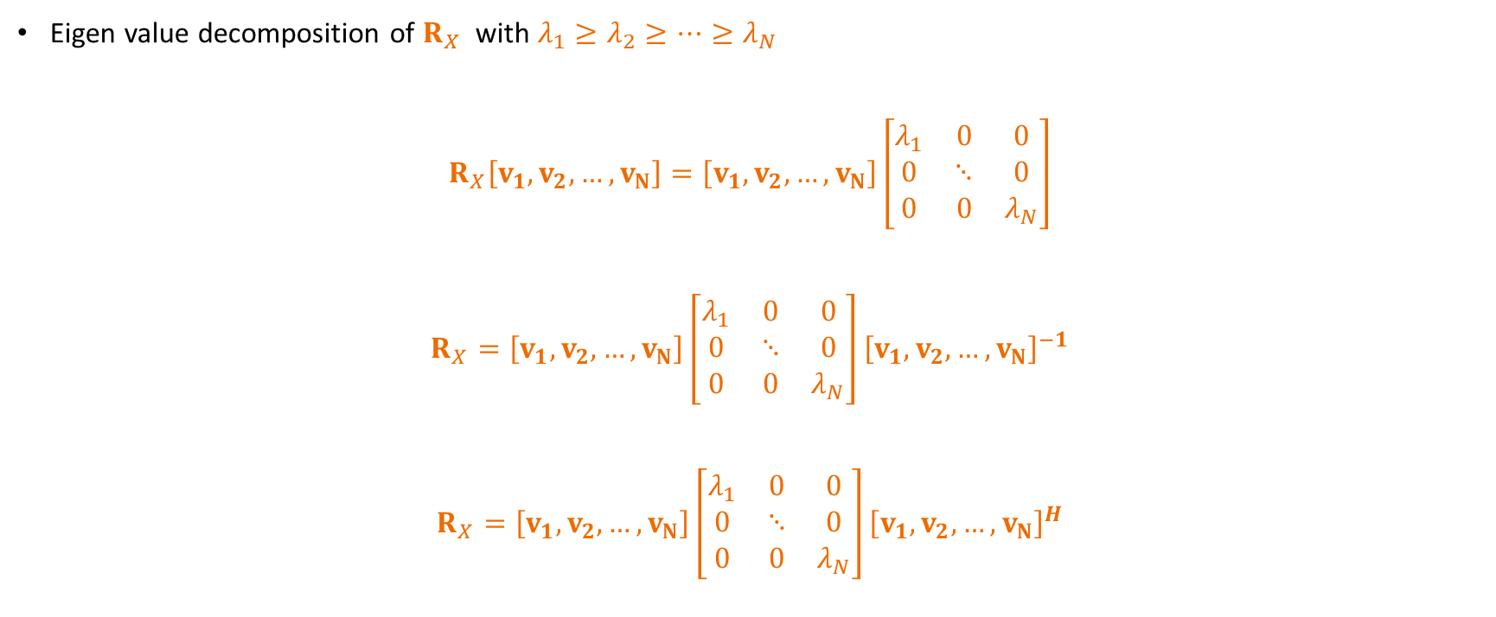
MUSIC Algorithm
Eigen value decomposition of $R_{X}$ with $λ_{1}≥λ_{2}≥…≥λ_{N}$
$$R_{X}\left[v_{1},v_{2},…,v_{N}\right]=\left[v_{1},v_{2},…,v_{N}\right]\left[\begin{matrix}λ_{1} & 0 & 0 \\ 0 & ⋱ & 0 \\ 0 & 0 & λ_{N}\end{matrix}\right]$$
$$R_{X}=\left[v_{1},v_{2},…,v_{N}\right]\left[\begin{matrix}λ_{1} & 0 & 0 \\ 0 & ⋱ & 0 \\ 0 & 0 & λ_{N}\end{matrix}\right]{\left[v_{1},v_{2},…,v_{N}\right]}^{−1}$$
$$R_{X}=\left[v_{1},v_{2},…,v_{N}\right]\left[\begin{matrix}λ_{1} & 0 & 0 \\ 0 & ⋱ & 0 \\ 0 & 0 & λ_{N}\end{matrix}\right]{\left[v_{1},v_{2},…,v_{N}\right]}^{H}$$
Unitary since $R_{X}$is complex symmetric

Slide 33
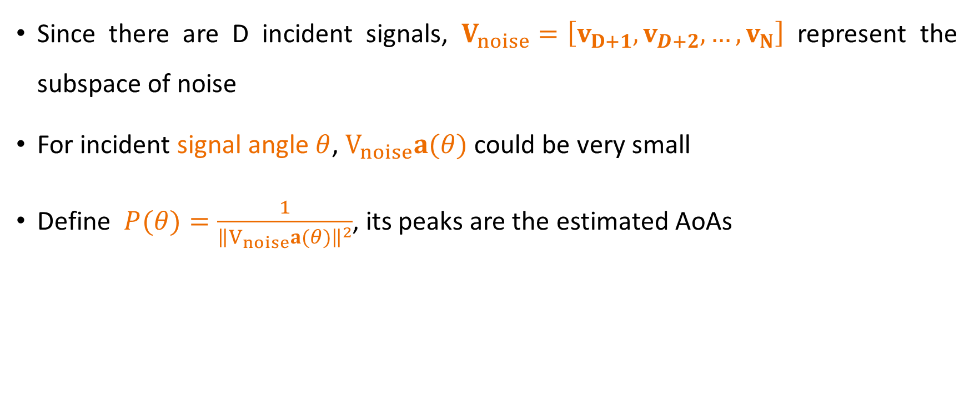
MUSIC Algorithm
Since there are D incident signals, $V_{noise}=\left[v_{D+1},v_{D+2},…,v_{N}\right]$ represent the subspace of noise
For incident signal angle $θ$, $V_{noise}a(θ)$ could be very small
Define $P(θ)=\frac{1}{{\left\|V_{noise}a(θ)\right\|}^{2}}$, its peaks are the estimated AoAs

Slide 34

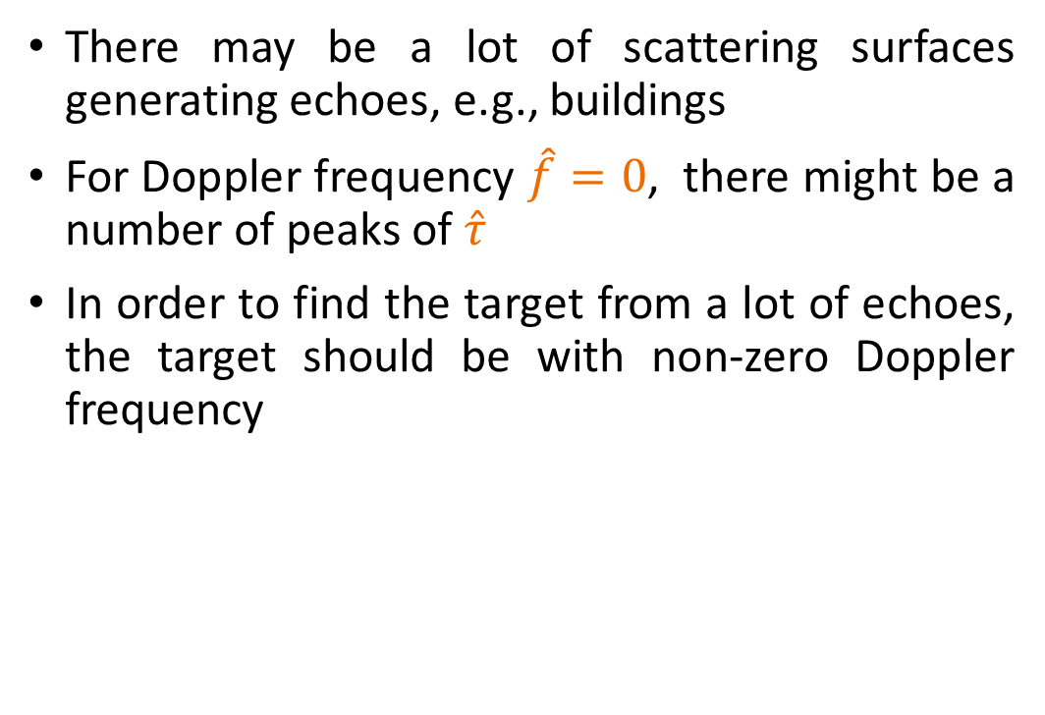
Limitation of Sensing
There may be a lot of scattering surfaces generating echoes, e.g., buildings
For Doppler frequency $\hat{f}=0$, there might be a number of peaks of $\hat{τ}$
In order to find the target from a lot of echoes, the target should be with non-zero Doppler frequency

Slide 35
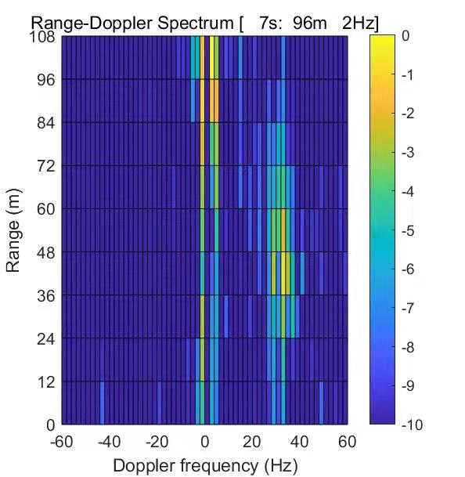
Limitation of Sensing

Slide 36
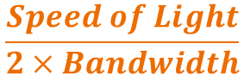
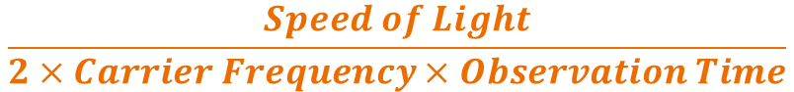
Limitation of Sensing
Range resolution
Velocity resolution
$$\frac{Speed of Light}{2×Bandwidth}$$
$$\frac{Speed of Light}{2×Carrier Frequency×Observation Time}$$

Slide 37
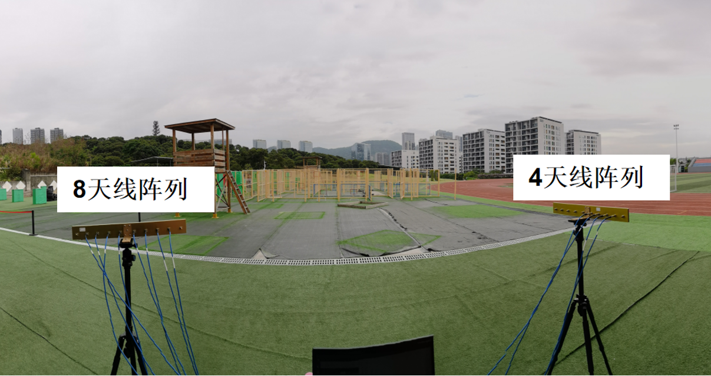
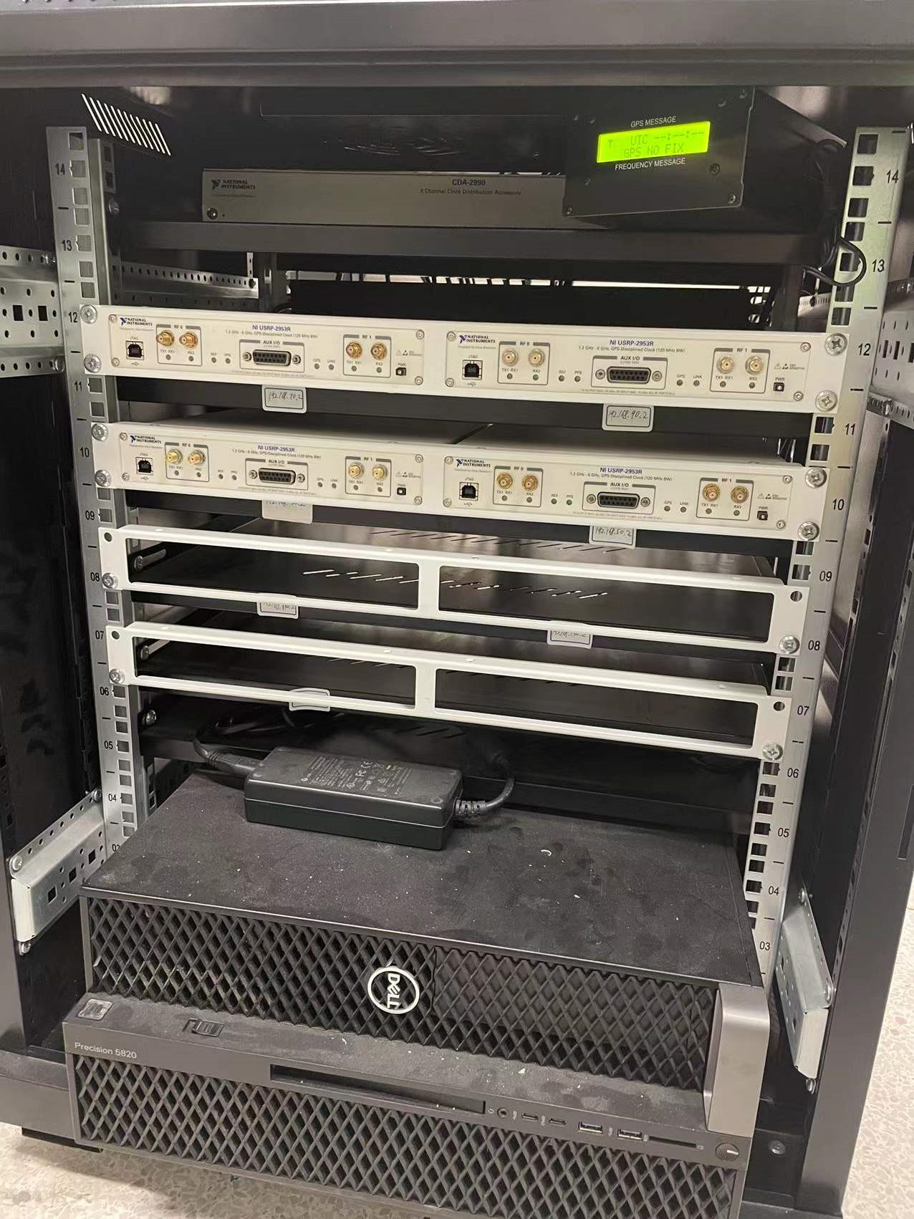
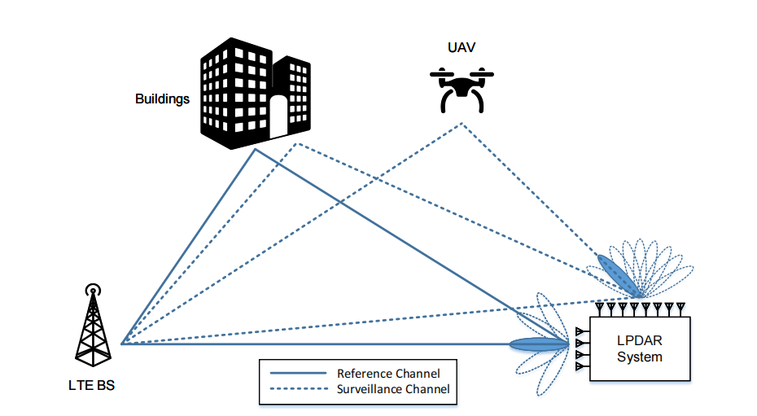
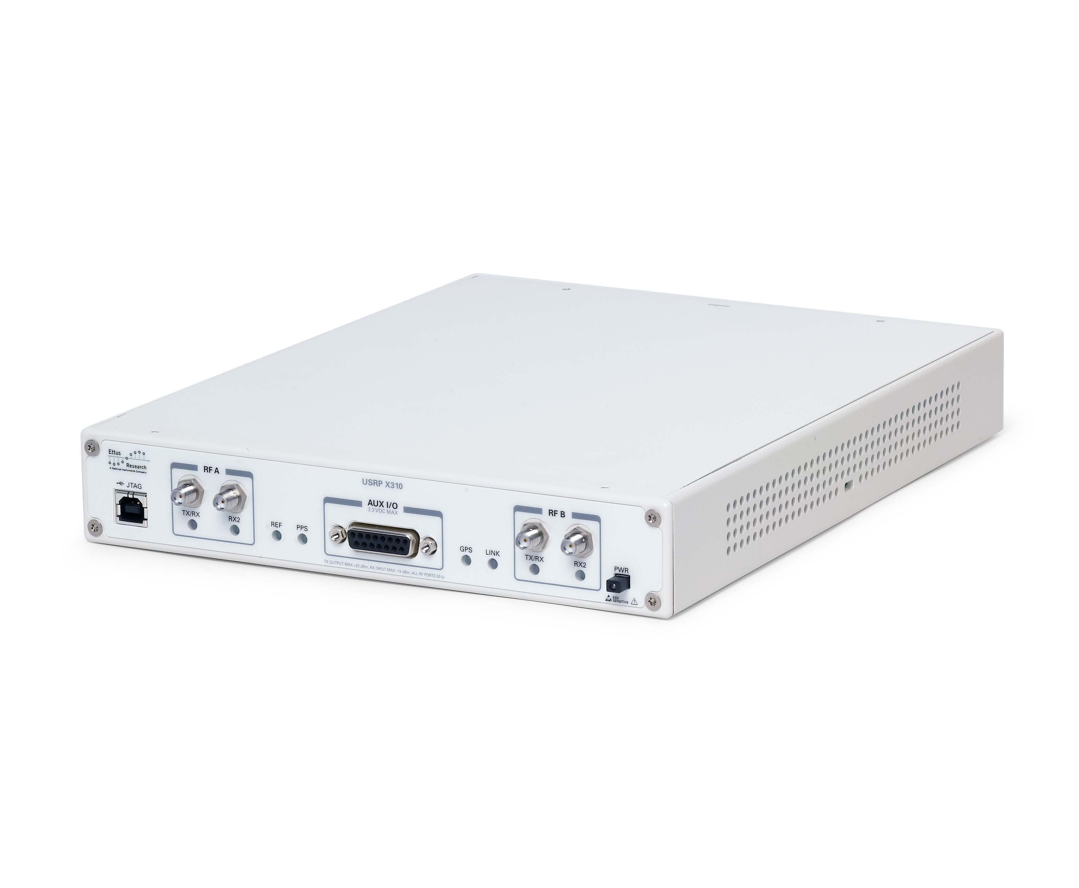
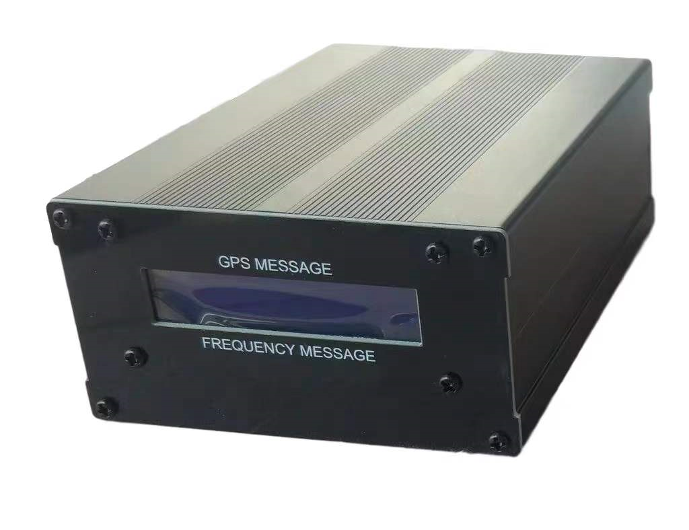
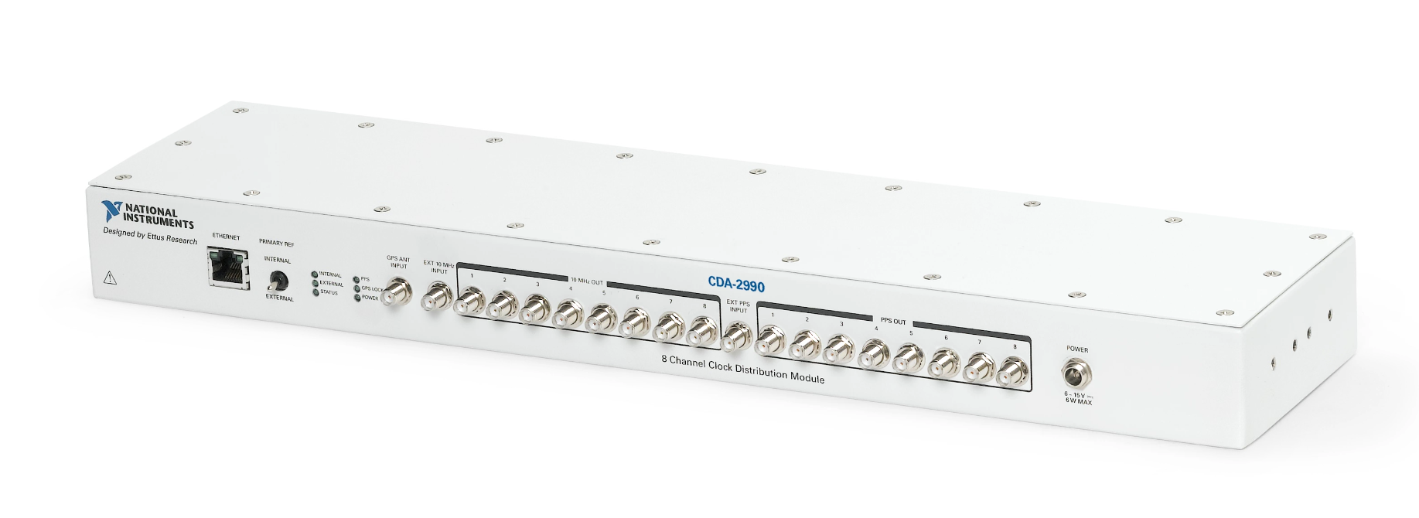
低空运动监测（Sub-7GHz）：利用LTE信号，被动感知无人机（或人），对其定位、追踪。
CDA-2990 时钟同步
USRP
GPS 时钟
基于被动雷达的低空运动监测
MIMO-被动雷达系统

Slide 38
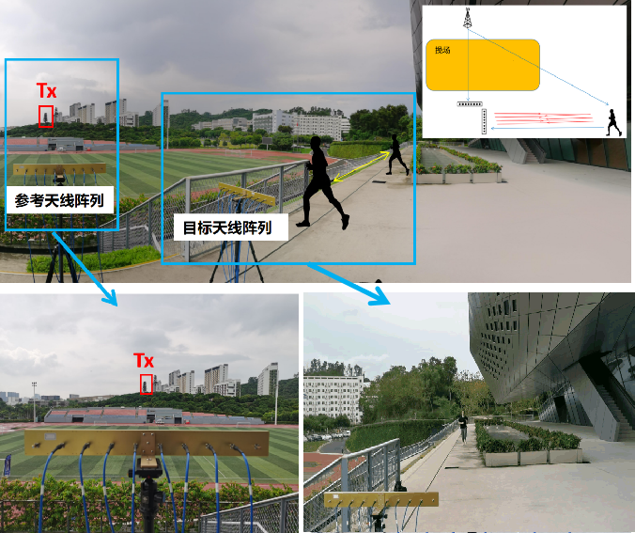
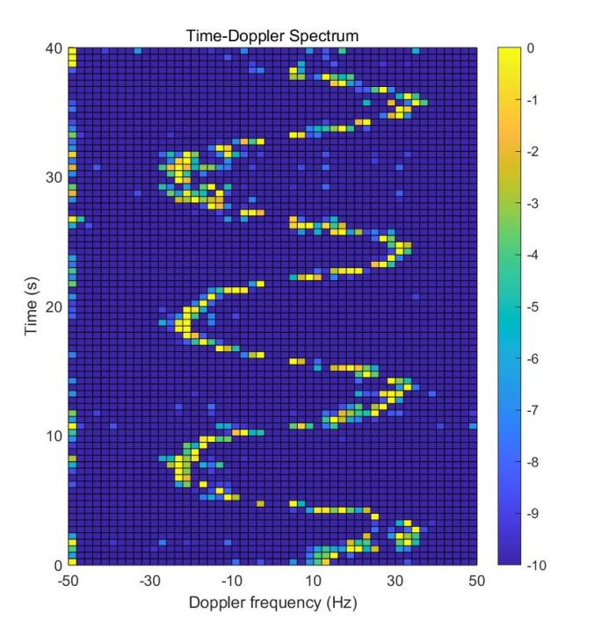
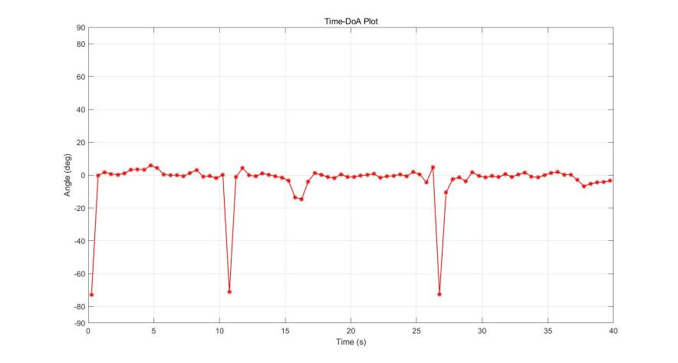
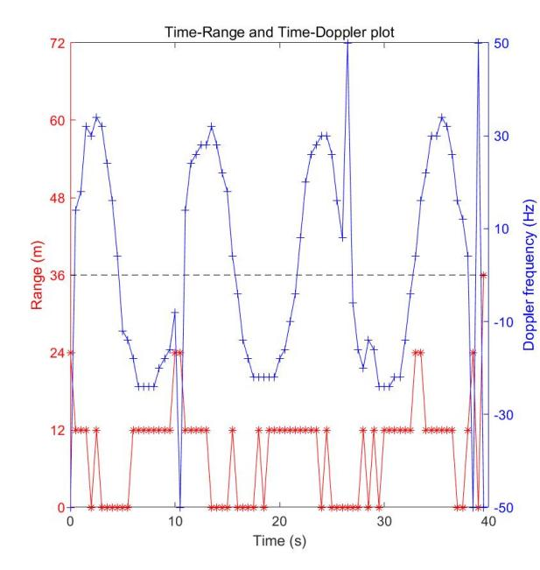
实验结果
直达波/杂波消除
比较稳定地估计在0°左右（正前方）
跑远
（负多普勒）
跑近
（正多普勒）
到达角-时间图
Target
时间-多普勒谱
跑近
（正多普勒）
跑远
（负多普勒）
距离在0m和12m间周期变化
人体运动实验场景（润扬体育场三楼外平台）
目标多普勒/距离-时间图

Slide 39
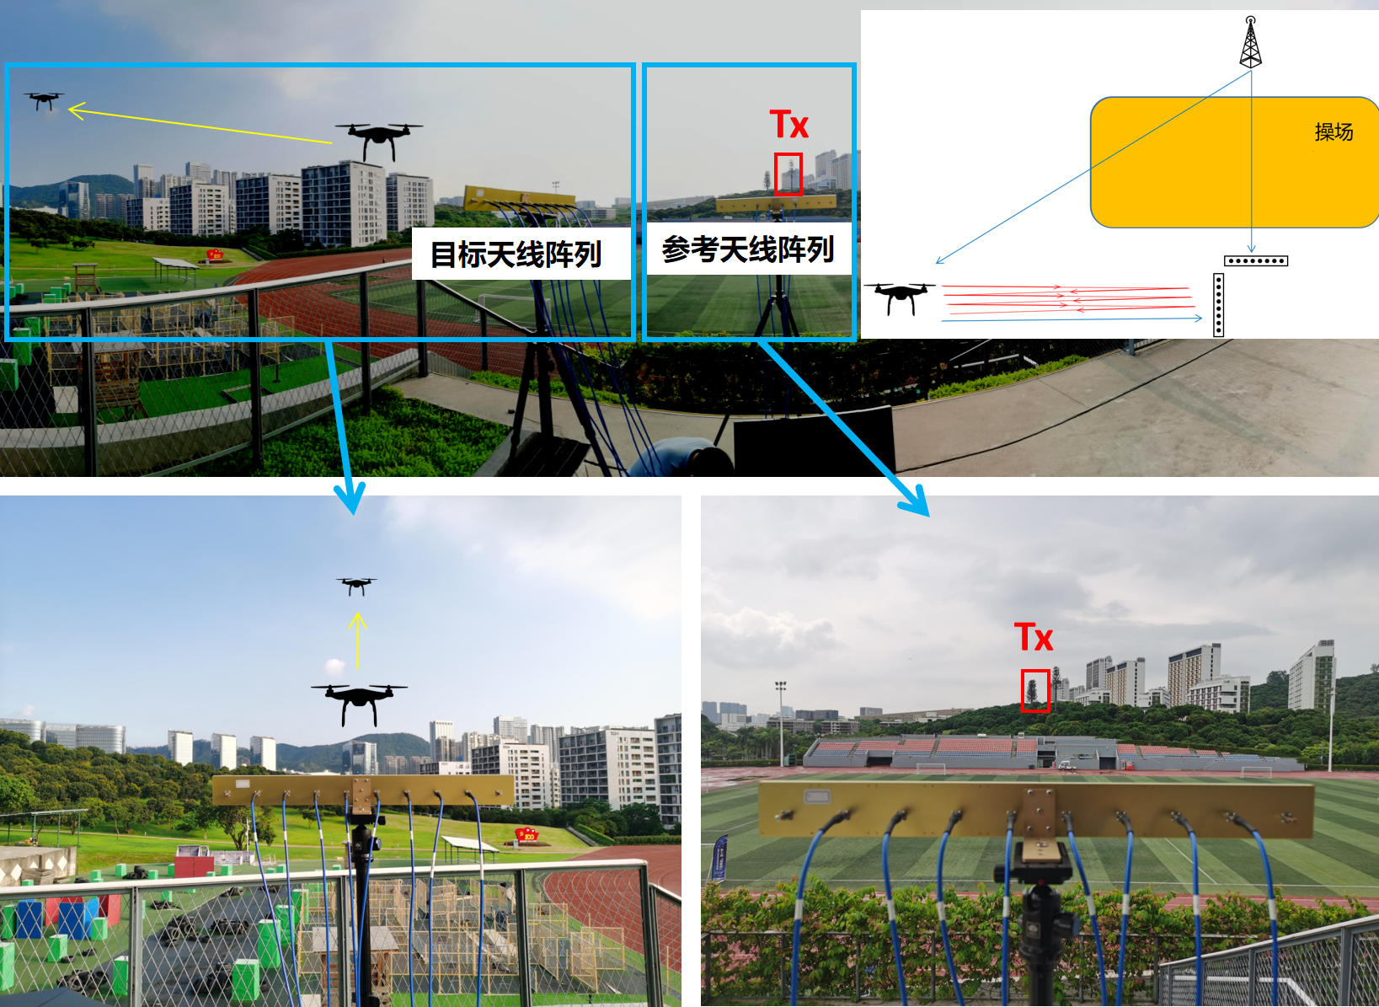
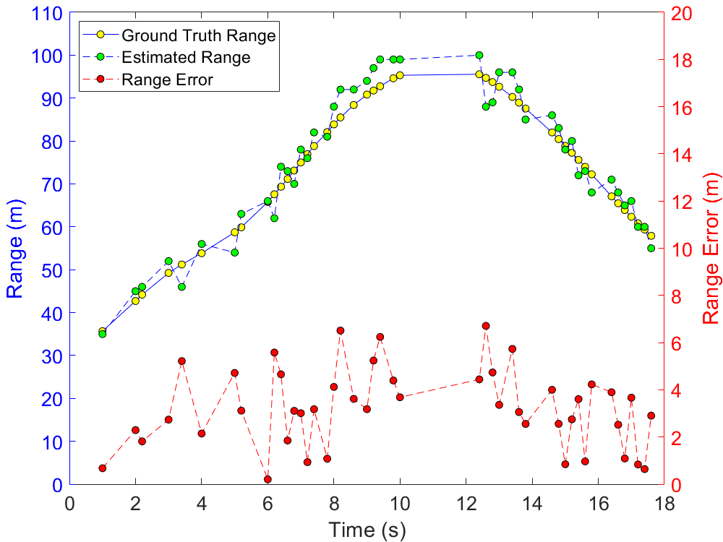



误差分析
距离平均误差3.03m
无人机运动实验场景
(5.6,0.9)
距离估计误差
距离误差CDF分析
角度平均误差为2°
(3.4,0.9)
无人机飞行轨迹估计
AoA估计误差
AoA估计误差
AoA误差CDF分析

Slide 40



mmWave Passive Sensing
60GHz phased array
Hand gesture recognition
Both LoS and NLoS are used as reference channel

Slide 41
mmWave Passive Sensing
Reference Channel：LoS
Reference Channel：NLoS

Slide 42
Alternative: Sensing via CSI
The variation of CSI is driven by Doppler effect
The Doppler effect can be observed from CSIs of one period
F. Adib and D. Katabi, “See through walls with wifi!” SIGCOMM 2013.

Slide 43




(1, 0.92)
LoS
Accuracy：94%
NLoS
Accuracy vs. Sensing Time
Resnet18
Accuracy：92%

Slide 44




Camera-Based Motion Capture

Slide 45


多链路被动书写轨迹追踪
Notes:
为了还原真实的人体运动速度，需要获取两个方向上的速度分量合成真实速度。因此在单链路设置的基础上，加入一个新的监视天线。多天线的加入也能提高轨迹追踪的精度。多链路追踪的处理流程如图所示。卡尔曼滤波这里运动到了张大庆组的多普勒和速度换算，获取到更加精确的速度信息再利用卡尔曼滤波来进行目标的轨迹重构。

Slide 46


多链路被动书写轨迹追踪
REF1
SUR2
SUR1
WRITING
PLATFORM
Notes:
利用前面提到的多通道采集系统实现三通道同步数据采集参考天线对准发射天线方向，两个监视天线 SUR1 和 SUR2 放置的位置互相垂直，面向书写平台，三路信号通过共用时钟保证同步采集，消除本证泄露的影响。

Slide 47

多链路被动书写轨迹追踪
Notes:
这个是一些书写数字结果的展示，我们在书写平台写下0,1,3,8等简单数字，每次书写的采集时间为 5 秒，以（0,0）作为初始点进行轨迹重构。横坐标表示 x 轴方向上的位置，纵坐标表示 y 方向上的位置。结果也表明了毫米波被动雷达系统具有书写追踪的能力

Slide 48


跨障碍物追踪
毫米波通信信号缺点：视距传输易受阻挡
Notes:
由于毫米波通信信号视距传输易阻挡的特点，因此后续实验也探究了利用墙体反射面，通过反射进行非视距跨障碍物被动手势追踪。系统的具体摆放如图所示。

Slide 49



多链路被动书写轨迹追踪
90%误差在5mm以内
轨迹误差在毫米级精度
Notes:
这三张图片（数字 3，7 和五角星）是跨障碍物书写的轨迹追踪结果和误差分析结果。红色轨迹显示的是ipad记录的真实轨迹，蓝色轨迹为实验得出的追踪轨迹，从右图的累计分布函数中可以看出，中值误差在 5mm 以内，轨迹误差在毫米级精度。

Slide 50


2
链路预警系统--mmAlert
mmAlert
信号处理流程
信道模型
参考波束与 LoS路径对齐
监视波束周期性地扫描
Reference:
Surveillance:
动态路径
静态路径

Slide 51








2
链路预警系统--mmAlert
实验场景
各波束的多普勒谱
波束1
有杂波
波束2
波束3
误检
系统参数 | 值
扫描波束数量M | 4
波束方向$φ$ | 144°,153°,162° , 169°
波束持续时$间T_{b}$ | 0.025 s
扫描周期$T_{d}$ | 0.1 s
波束4
无目标
观测时间
阻塞

Slide 52


2
链路预警系统--mmAlert
运动模型
假设阻塞目标是以匀速直线的状态运动
初始位置$(x_{1},y_{1})$、运动速度 $v$、方向$θ$
K个扫描周期
优化问题
测量特征
位置
穷举搜索
AoA
阻塞预测
轨迹特征
Doppler
阻塞概率

Slide 53




2
链路预警系统--mmAlert
实验数据介绍：
共100组实验（80组链路中断，20组不中断）
2位志愿者，正常行走速度（约1m/s - 2m/s）
$$P_{B}>0.9$$
$$P_{B}>0.9$$
实验示意图
观测时间与预测概率的关系
预警准确率随提前预警时间变化

Slide 54
Sensing of Environment
With AoA, AoD, and path length, the following information can be detected:
Relative position of Rx w.r.t. Tx
Layout of walls

Slide 55
Sensing of Environment

Slide 56
What can be done via sensing
Velocity and location of target
Motion of human
Indoor layout
Methods:
Range and Doppler: Active, Passive and Channel State Information
Angle of Arrival, Angle of Departure, Time of Flight

